Slide 1



Slide 2

An Android based Application for Automobile
Supervised by:
Mr. Yasir Ali Shah
Group Member:
Nabeel Hassan (FA17-BCS-054)
Department of Computer Science
COMSATS University Islamabad, Attock Campus

Slide 3
Introduction
Android Application for Automobile provide the services that are relevant to the car inspection like car towing, car repairing and locksmith etc.
Information Technology allows the user to select any available service through our app.
. It provides services to user at low and reasonable price and user can easily reach at their destination without any hesitation.

Slide 4
Outline
Introduction
Problem Statement
Workflow
Objectives
Development Requirements
GUI
Modern Tools
Methodology
Advantages

Slide 5
Problem Statement
When a person can travel one place to another. Car can stop some place in the road and can not start.
He/she can worry how we can him/her go to the final destination.

Slide 6
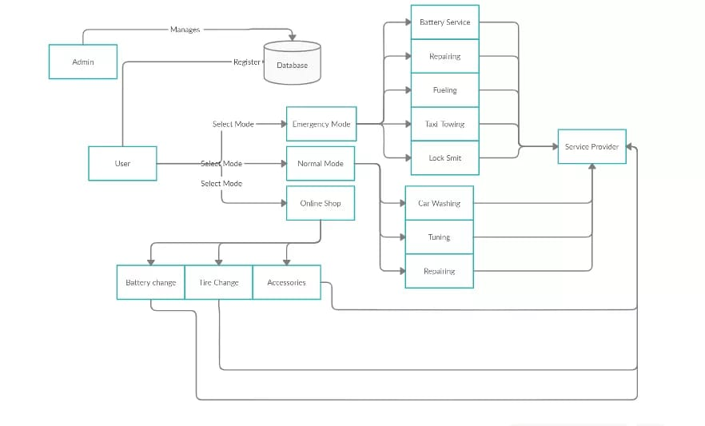
Work Flow

Slide 7
Objectives
Android Application for Automobile provides the complete package of services.
Following services are
Taxi Towing
Repairing
Locksmith
Fueling and Battery relevant Service

Slide 8
Related Work
1 American Automobile Association
The American Automobile Association (AAA) is a federation of motor clubs throughout North America. AAA is a non-profit member service organization with over 58 million members in the United State and Canada. AAA provides services to its members, including roadside assistance and others. Its national headquarters are in Heathrow, Florida.
2 Canadian Automobile Association
The Canadian Automobile Association commonly known as (CAA) is a non-profit federation, founded in 1913, of eight motor clubs across Canada, providing roadside assistance service, insurance services, and member discount.

Slide 9
Development Requirements
Software Requirements:
IDE: Android Studio
Programming Language: JAVA, XML
Database: My Sql

Slide 10

Splash screen of app

Slide 11
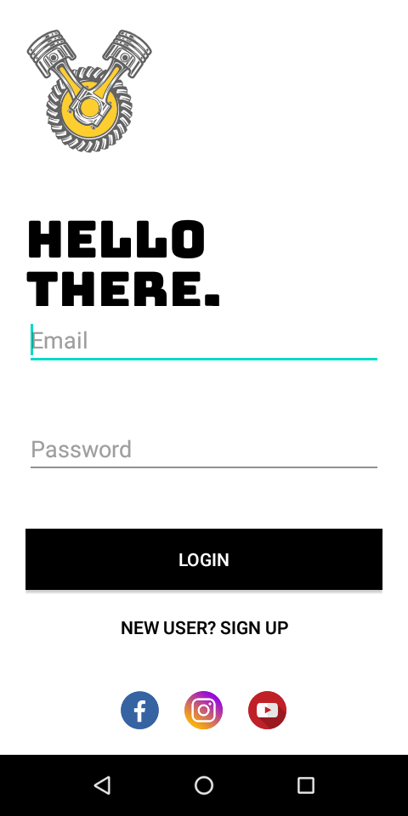
Login screen of App

Slide 12
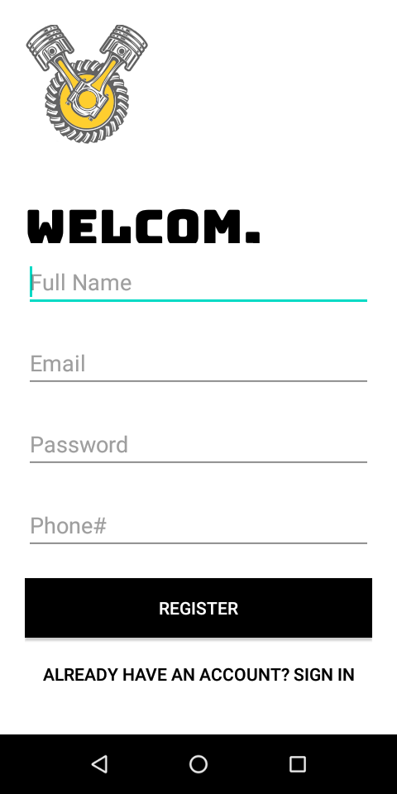
Register user in App

Slide 13
Modern Tools
Tools | Version | Rationale
Android Studio | 4.0.0 | IDE
MS word Document | 11.2.0 | Documentation
MS powerpoint Presentation | 11.2.0 | Presentation
My SQL | 17.5.0 | DBMS
Technology | Version | Rationale
JAVA, XML | 6.0 | Programming Language

Slide 14
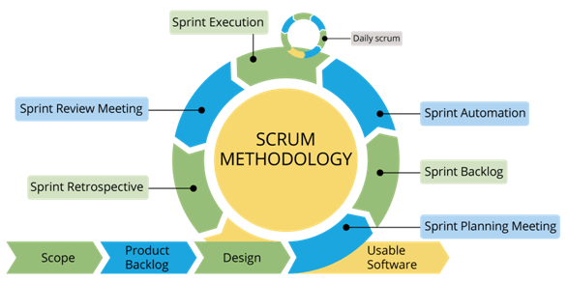
Methodology
Selection of this methodology as we are developing in increment forms so if change require after result showing to supervisor.
Can easily get break point so we able to change as supervisor tells us

Slide 15
Advantages
1. Easy to use:
You can find the ideal service for your car at the tip of your fingers with the help of a car service app. All you must do is enter your car details, your car make and you’re ready to go. Open the app, select the service you’re looking for, and then sit back, relax and let the experts get the job done for you.
2. Deals, discounts and offers:
Service providers generally provide discounts and special festive offers on a car service app. You can always avail these discounts if you have the app installed on your smartphone. Some service providers also provide free service based on referrals and coupons. Keep an eye out for offers and choose the best car repair offers that are aligned along with your service date. This would help you get a quality service at discounted prices.

Slide 16
Thank you

